Slide 1
Week 4 Lab
CIS 347 / SOC 395
Disk & Data Recovery

Slide 2
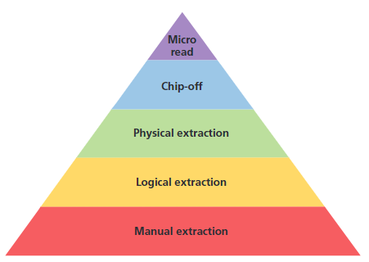
Extraction Techniques

Slide 3
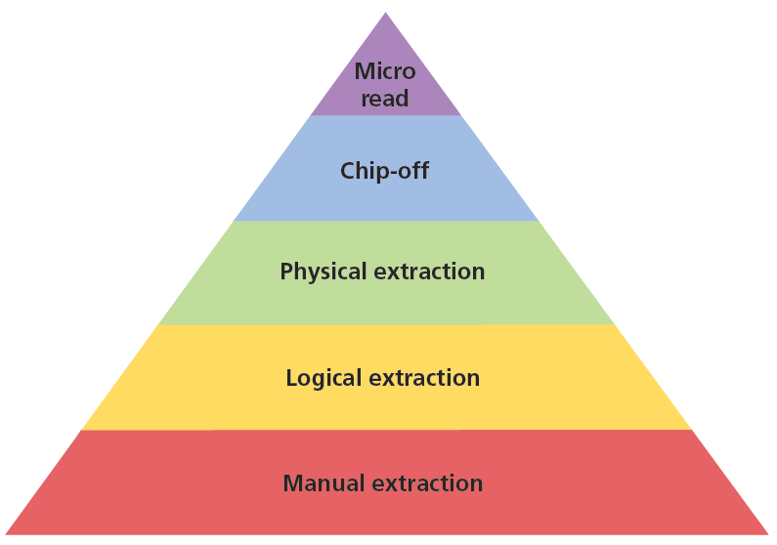
Manual techniques involve using standard inputs included with or built into the device, such as touch screens or keyboards.
This is the most basic level of extraction as it does not require specialized tools, though knowledge of file structure and operating systems will aid considerably in analysis.
This level of processing is comparable to sitting at a computer looking for a particular file by exploring file folders with a mouse and keyboard.

Slide 4
Logical extractions skip any “deleted” data, only extracting only allocated space.
This level of processing is comparable to using a DOS prompt to control a computer rather than a modern operating system.

Slide 5
Digital evidence at this level can tap into deleted information.
Needless to say, this level requires more knowledge and tools than previous levels, but the potential evidence is both greater in quantity and more difficult for a suspect to alter.

Slide 6
The final processing options, JTAG, chip-off and micro read, are highly technical activities and represent advanced digital evidence extraction.
Both involve physically accessing physical components.
Attempts to read the stored information are done directly with the memory chip and not through the device, so the examiner needs to know proprietary details regarding communication with the chip and needs to simulate the device’s communication process.

Slide 7
What makes forensic recovery possible?
You need to understand how data in a computer system works. Computers become faster by two methods – technology advances and cutting corners. Computers are not built for security or privacy they are built to do work as fast as they possibly can.
That has a lot of ramifications, but primarily there is often a misconception in what “deleted” means.

Slide 8
Lots and lots of switches.
All information is stored in binary form. Binary is 1 or 0, yes or no, on or off.
A single 1 or 0 is known as a bit.
8 bits is a byte.
1000 bytes is a kilobyte (kb)
1000000 bytes is a megabyte (mb)
1000000000 bytes is a gigabyte (gb)

Slide 9
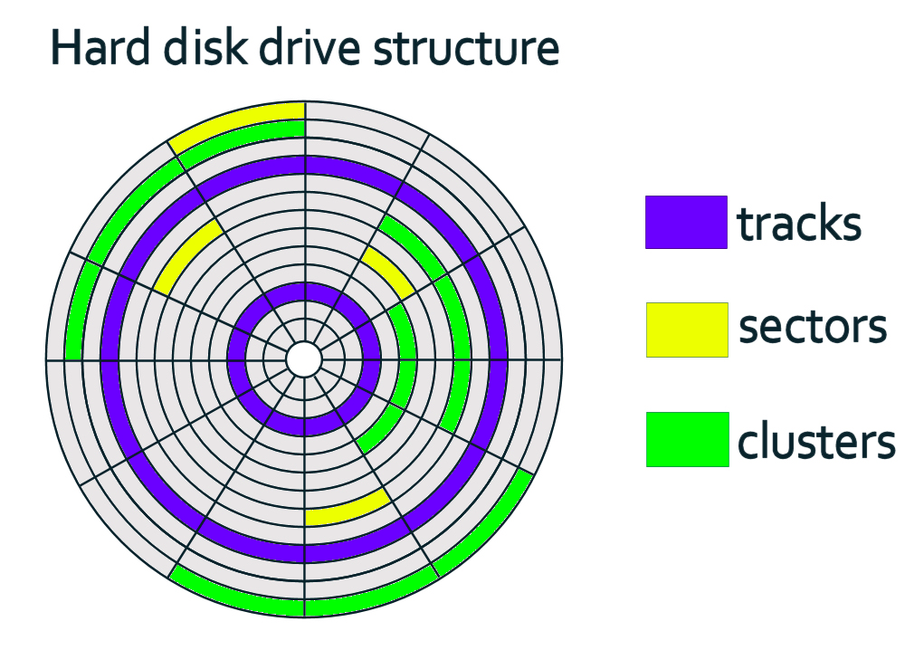
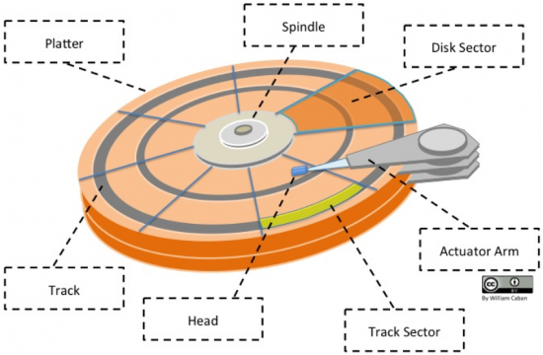
Data Organization on HDDs

Slide 10
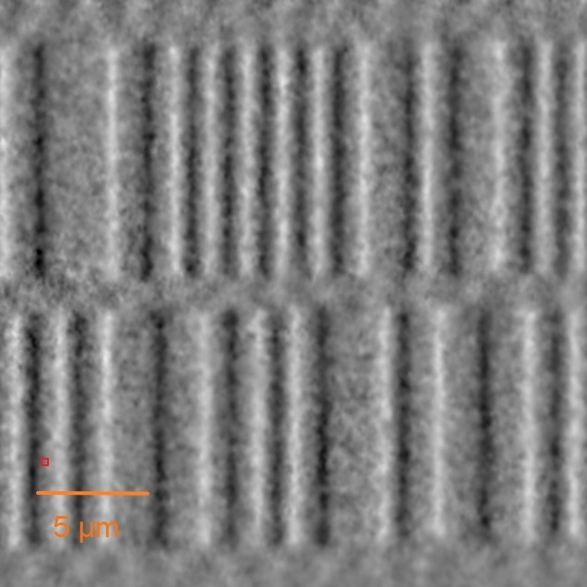
Data Organization on HDDs
On a magnetic disk, the 1s and 0s are a result of the read/write head (moving accurately due to a Lorentz force) detecting flux reversal on the magnetic media – a process known as Faraday’s Law of Induction.
Essentially, imagine a magnet with a north and south pole. When the head floats over the platter, if there is a change in polarity, it will register. If not, it won’t. Hence, 1s and 0s. This is very simplified, but that’s the idea.
N | N | S | S | N | S | S | N | N | N
0 | 1 | 0 | 1 | 1 | 0 | 1 | 0 | 0

Slide 11
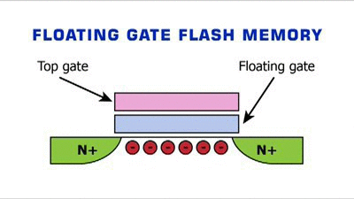
How SSDs work

Slide 12
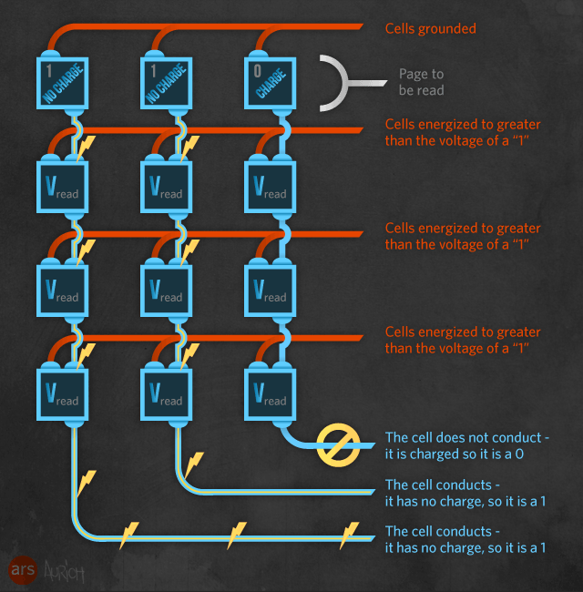
How SSDs work

Slide 13
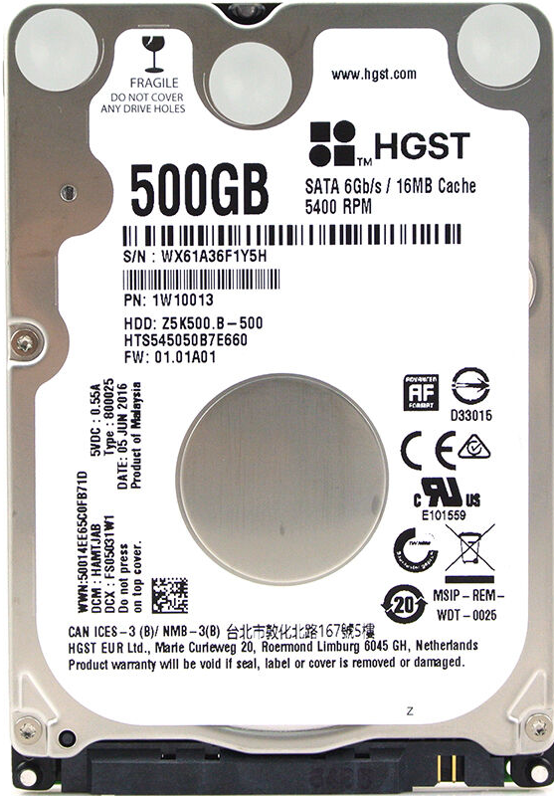
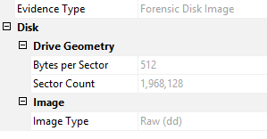
Drive Geometry
That label sure makes reading the drive geometry easy, but it might not always be available.
512 byte/sector * 1,968,128 sectors =
1,007,681,536 bytes, or 1,007MB, or ~1 GB
If we had other drive geometry data, such as cylinders, heads, sectors per track we could do this as well.
Cylinders * heads * sectors/track * bytes/sector = Size.
SSDs use similar nomenclature, though they work completely differently.

Slide 14
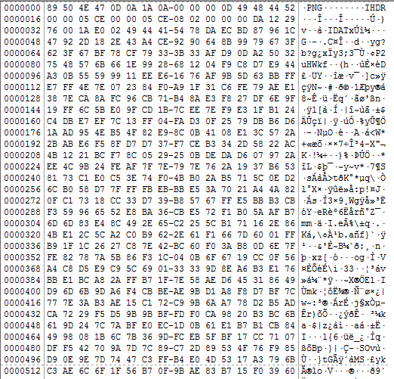
100110111010110110110110110110001010110111
So data on disk is just a bunch of 1s and 0s, but that is obviously not very friendly to humans. It’s especially not friendly if we’re trying to forensically read data, as it’s hard for us to sift through to find meaningful data with billions of lines of binary in front of us.
That’s why when you’re looking at a disk in a forensic tool like FTK, it’s displayed in hexadecimal format. Essentially, we take 1s and 0s (known as bits), group them into 8 bits (a byte) – two groups of four, then convert them to base 16 to form what is known as a byte pair.
Observe: Hex b16 = 0123456789ABCDEF
1 | 1 | 0 | 1 | 0 | 0 | 1 | 1
8 | 4 | 2 | 1 | 8 | 4 | 2 | 1
8 + | 4 + | 0 + | 1 = | 0 + | 0 + | 2 + | 1 =
13 | = | D |  | 3 | = | 3
Byte Pair = | D | 3

Slide 15
A sector.

Slide 16
Offsets.

Slide 17
Raw data. Byte pairs.

Slide 18
WTF is Hex
And how is this binary?
Binary is 1s and 0s.
0000 is 0
0001 is 1
0010 is 2
0011 is 3
0100 is 4 and so on...
There are 16 possible combinations (binary choice = 2) * 4 slots = 4^2 = 16…
Hexidecimal is shorthand. We have a character that represents 1 of those 16 – 0-9 are literal. A-F signify 10-15.
Each 1 or 0 is a BIT. 8 bits make a BYTE. So two hex characters = 1 BYTE, hence “byte pairs”
So we can write AF and it is the same as 10101111

Slide 19
WTF is Hex
And what is decimal?
So we can write AF and it is the same as 10101111
Decimal is just a numerical expression of that same data. The highest value that can be expressed by a single byte pair is FF (00 through FF) there are 256 positions in that range.
Hex: 00 Binary: 00000000 Decimal: 0
Hex: FF Binary 11111111 Decimal: 255

Slide 20
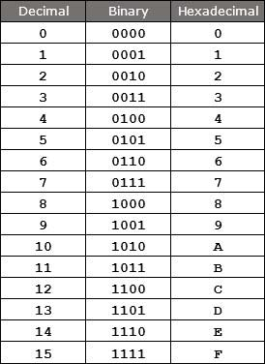
WTF is Hex
And how is this binary?

Slide 21
ASCII translation of byte pairs.

Slide 22
So WTF is ASCII now?
Binary can be converted to hex or decimal and it all means the same thing.
ASCII is another way to translate that exact same data…

Slide 23
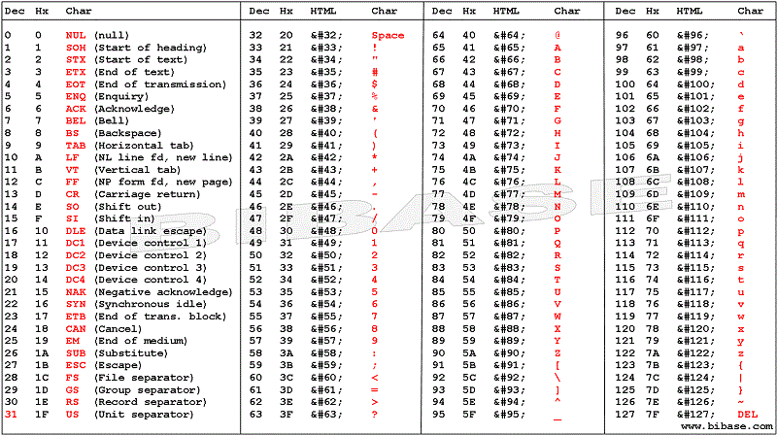

Slide 24
It gets worse
ASCII isn’t the end, though. Other encoding standards like Unicode, for example.
7-bit ASCII supports 127 characters. 16-bit Unicode supports 65,536 (codes 32 – 127 are the ASCII characters.)
All data is just encoded binary data

Slide 25
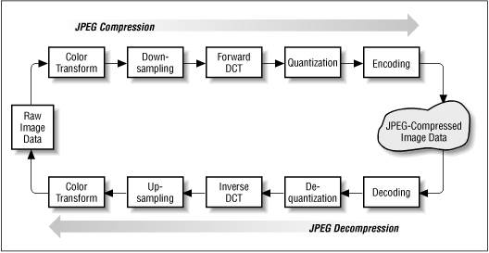

Slide 26
File signature aka File Header. 89 50 4E = PNG FF D8 FF = JPG Start of a file.

Slide 27
Navigating offsets
When navigating offsets, keep your conversions in mind. Drive geometry matters.
Assuming your view spans 16 bytes per row, each offset will be 16 byes (hex, 10 dec)
This is BYTES. Files are references in filesystems by SECTORS. The default now is 512 bytes per sector.
So… if you find a file signature in 820A00 hex / 8522240 dec you need to convert that to sectors…. 8522240 / 512 = 16645. The file begins in sector 16645 (dec).
If the EOF is in sector 16692 you need to convert again. 16692 * 512 = 8546304. The file spans from offset 8522240 to 8546304 (all in dec)

Slide 28
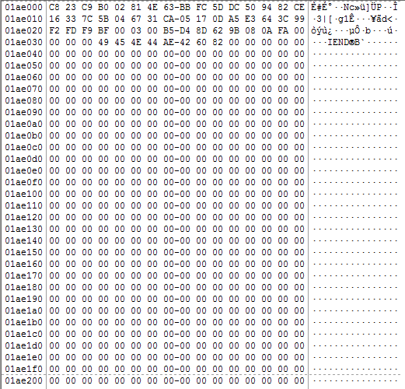
EOF aka End marker 49 45 4E = PNG FF D9 = JPG End of a file.

Slide 29
Areas of the Disk to know
Looking at the drive in this way can tell you a lot of information about the system.
Sector 0 usually contains the MBR (master boot record), which can have up to four partitions (what most refer to as the “drives”) – it will then include the file system for each partition.
07: NTFS
54 to 61: FAT, FAT12, FAT16
0B or 0C: FAT32
83: Linux
EE: EFI GPT partition (commonly used for Mac HFS+)

Slide 30
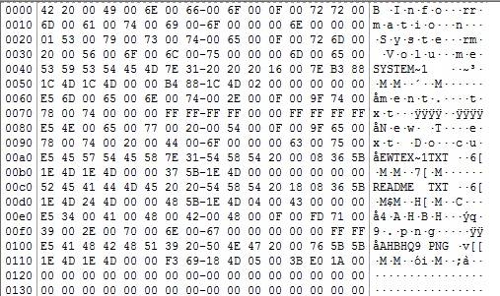
The disk might also contain a listing of all files in the MFT or FAT

Slide 31
Disk and Data Recovery
First, an explanation of file systems:
FAT stands for File Allocation Table. Older FS type that stores data in 32-bit /16-bit/whatever chunks. Less common today, but found most frequently on removable media (flash drives.)
NTFS stands for New Technology File System. Supports file-level access control.
The two have important technical differences:

Slide 32
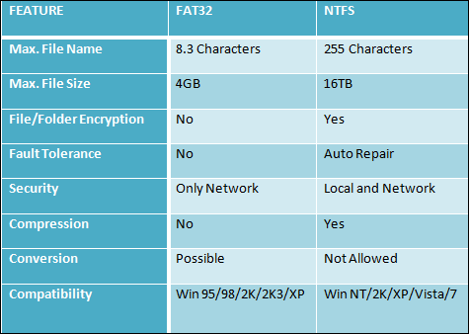
FAT vs NTFS

Slide 33
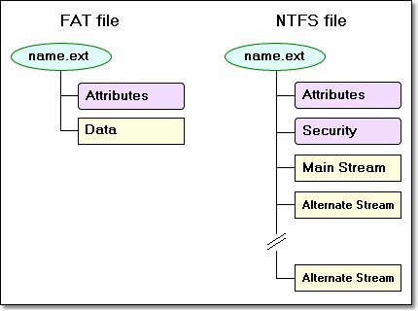
FAT vs NTFS

Slide 34
FAT
FAT is by far the most simplistic of the file systems supported by Windows
The FAT file system is characterized by the file allocation table (FAT), which is really a table that resides at the very "top" of the volume. To protect the volume, two copies of the FAT are kept in case one is damaged.
In addition, the FAT tables and the root directory must be stored in a fixed location so that the system's boot files can be correctly located.

Slide 35
FAT
A disk formatted with FAT is allocated in clusters, the sizes of which are determined by the size of the volume. When a file is created, an entry is created in the directory and the first cluster number containing data is established. This entry in the FAT table either indicates that this is the last cluster of the file, or points to the next cluster.
There is no organization to the FAT directory structure, and files are given the first open location on the drive. In addition, FAT supports read-only, hidden, system, and archive file attributes.

Slide 36
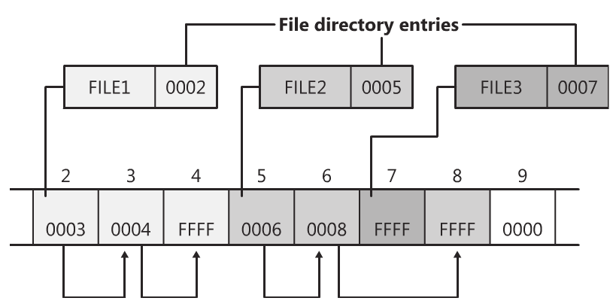
Data on Disk
The smallest increment of disk space that a file can reserve is a sector. If a file is larger than the size of a single sector (512 bytes, or whatever) then it will need to reserve several sectors. If contiguous sectors are not available, it will reserve sectors elsewhere. This data is considered fragmented.
The FAT file system will leave breadcrumbs to point to the next sector, until an EOF (end of file) is found.

Slide 37
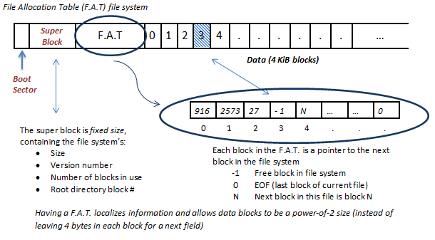
FAT

Slide 38
What is “deleted”?
Here’s the thing… When you delete a file, it’s not gone. It would be terribly inefficient for the computer to erase those bits every time a file is deleted.
Moving it is easy – just change the entry in the MFT or FAT.
Deleting it? Well, the quickest way to do that is to just remove the entry in the MFT or FAT, of course! So, when an item is “deleted” in a modern Windows OS – the reference to the file system changes to the recycle bin. When the recycle bin is emptied, the reference is removed. The data, however, is still on disk in the exact same place. The only thing that happens, is that area of disk goes from “reserved” to “unallocated.”
Unallocated space simply means that the space is available if needed to be reserved by another file.

Slide 39
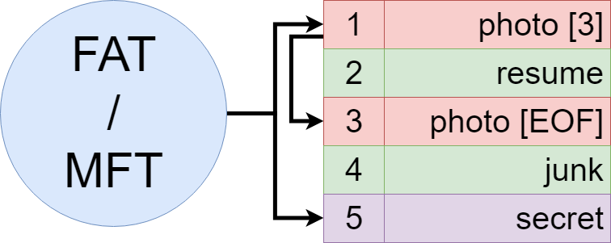
When data is deleted…

Slide 40
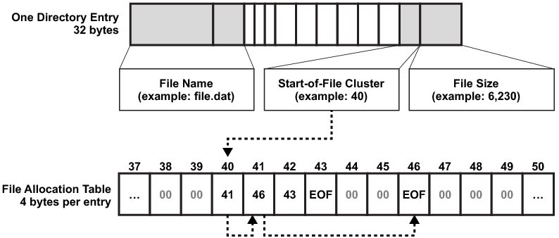
FAT

Slide 41
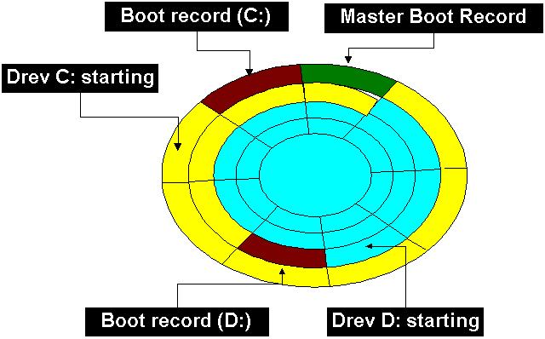
Data on Disk
What this also means is that if a file does not use up ALL of that last sector, then that data is untouched. The space between the end of a file and the end of the sector is known as slack space – or in this case more specifically file slack since there is slack space anywhere you will find demarcations of data sets – so disk slack, file system slack, etc.

Slide 42
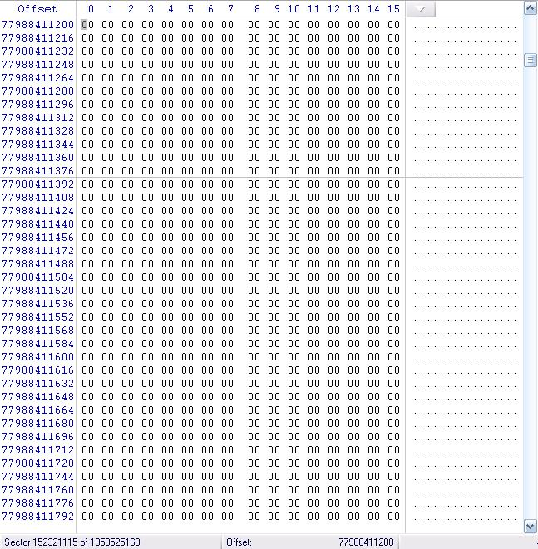
Slackers
So if data is on a disk in an area marked as unallocated, it could be retrieved with a technique known as file carving. Since this area of disk is unallocated though, it could be overwritten if we saved new data to the disk.
But what was that we just said about slack space? Yeah, data could still reside in slack space… And that area of disk is not unallocated – it is reserved. Meaning that data in slack space could hold onto that data, theoretically, forever.
The fix to this issue is “zeroing” a drive, also known as forensically wiping a drive. As a forensic scientist it is CRITICAL that your drives are clean. As a forensic scientist, it really sucks when a subject does this to erase evidence.
w | h | i | z | z | b | a | n | g | s
w | h | i | z | z | b | a | n | g | s
p | i | z | z | a | z | z | n | g | s

Slide 43
FAT
Advantages of FAT
The FAT file system is best for drives and/or partitions under approximately 200 MB because FAT starts out with very little overhead compared to NTFS.
Disadvantages of FAT
It is preferable to not use the FAT file system when using drives or partitions over 200 MB. This is because as the size of the volume increases performance with FAT will quickly decrease.
It is not possible to set permissions on files that are FAT partitions in their native form.
FAT partitions are limited in size to a maximum of 4 Gigabytes (GB) under Windows NT and 2 GB in MS-DOS.

Slide 44
NTFS
Advantages of NTFS
NTFS is best for use on volumes of about 400 MB or more. This is because performance does not degrade under NTFS, as it does under FAT, with larger volume sizes.
The recoverability designed into NTFS is such that a user should never have to run any sort of disk repair utility on an NTFS partition.
Since NTFS has no realistic limit on the number of clusters it can manage, it does not suffer from the same constraints on cluster size as FAT 32.

Slide 45
NTFS
Disadvantages of NTFS
It is not recommended to use NTFS on a volume that is smaller than 400 MB, due to the amount of space overhead involved in NTFS. This space overhead is in the form of NTFS system files that typically use at least 4 MB of drive space on a 100 MB partition.
It is not possible to format a floppy disk with the NTFS file system;
Windows NT formats all floppy disks with the FAT 12 file system because the overhead involved in NTFS will not fit onto a floppy disk.

Slide 46
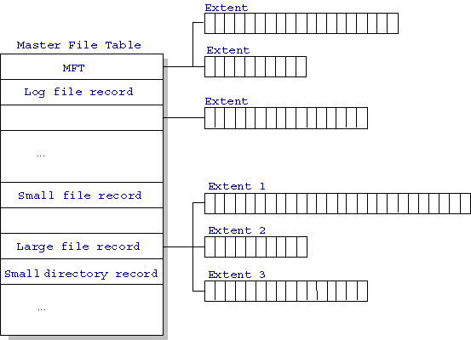
NTFS

Slide 47
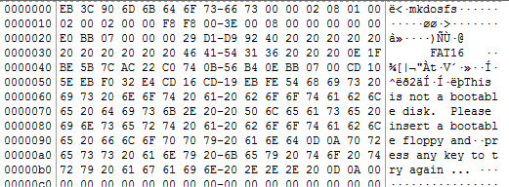
FAT – Finding the root
0x10 = Number of FATs
0x16 & 0x17 = Number of sectors before FAT (root directory)
F8 hex to decimal is 248
248 + 248 + 1 = 497. We will find the FAT in sector 497.

Slide 48
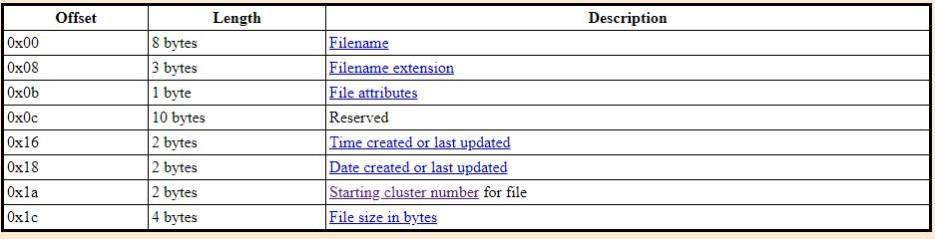

Slide 49
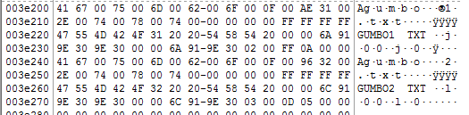
A FAT
0x01 Indicates that the file is read only.
0x02 Indicates a hidden file. Such files can be displayed if it is really required.
0x04 Indicates a system file. These are hidden as well.
0x08 Indicates a special entry containing the disk's volume label, instead of describing a file. This kind of entry appears only in the root directory.
0x10 The entry describes a subdirectory.
0x20 This is the archive flag. This can be set and cleared by the programmer or user, but is always set when the file is modified. It is used by backup programs.
0x40 Not used; must be set to 0.
0x80 Not used; must be set to 0.
003e220 to 003e225 is the file name
003e228 to 003e230 is the file extension
003e231 is the file attribute

Slide 50
A FAT
9E 30 = File modified date. (4/30/2004)
6A 91 = File modified time. (6:11:20 PM)
Created times are the same.

